Slide 1

MENTAL HEALTH SURVEY
Link :- https://www.kaggle.com/code/shrijoychowdhury/mental-health-survey-svm-decision-tree/data
By …………..

Slide 2

What is Mental Health ??
A Person’s condition with regard to their psychological and emotional well-being.

Slide 3
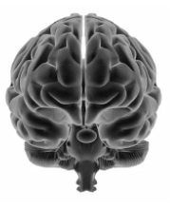
Dataset Information :-
This dataset is from a 2014 survey that measures attitudes towards
mental health and frequency of mental health disorders in the tech workplace.
The dataset contain 1259 Records and 27 columns
We are going to predict to have you sought treatment
for a mental health condition?
It’s a Classification Problem where our target variable
has 2 classes and we are predicting the treatment based on
Some feature that we have.

Slide 4
Feature to predict target variable
Time Stamp
Age
Gender
Country
Self Employed
Family History
Work Interfere
No Employees
Remote work
Tech Company
Benefits
Care Options
Wellness Program
Seek help
Anonymity
Mental Health Consequence
Phys health Consequence
Coworkers
Supervisor
Mental health review
Phys health interview
Mental vs Physical
Obs Consequence
Comments
Leave

Slide 5
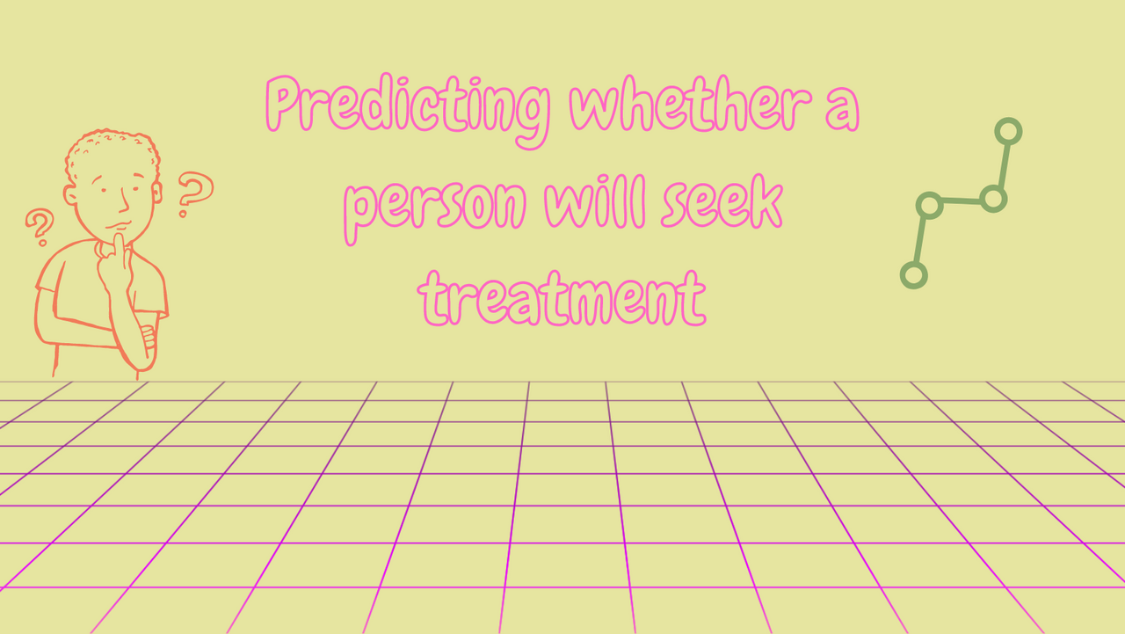
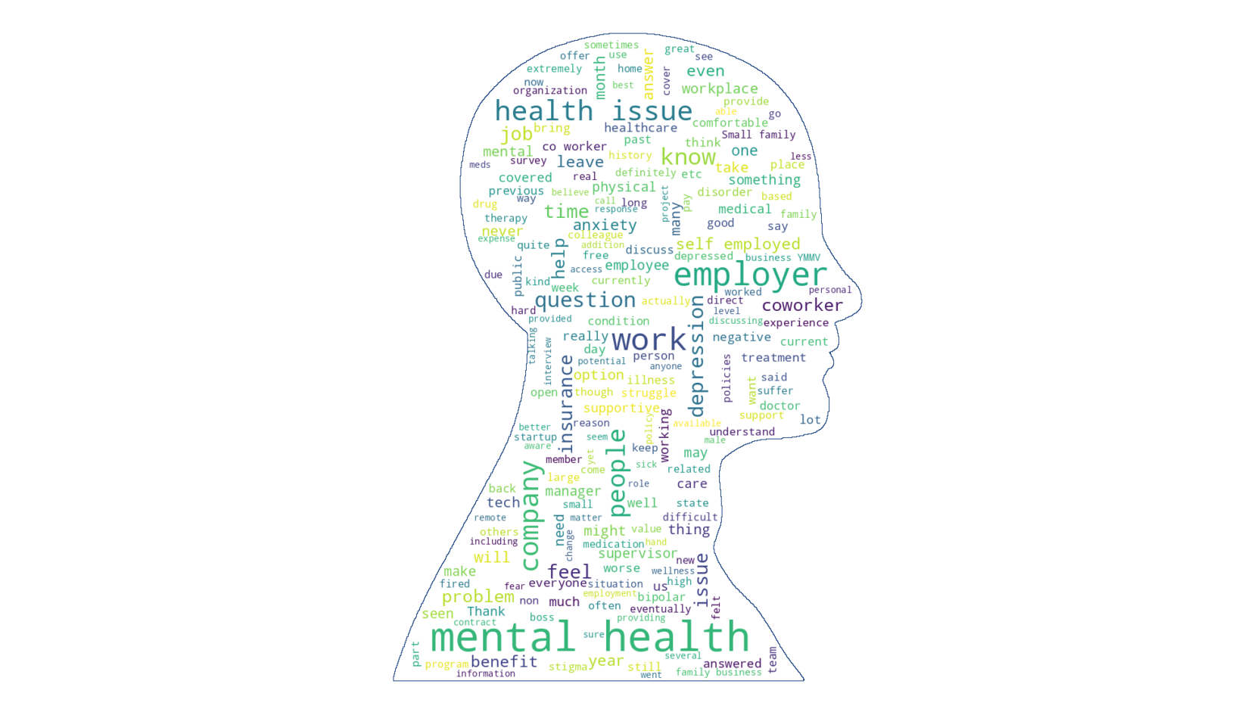

Slide 6
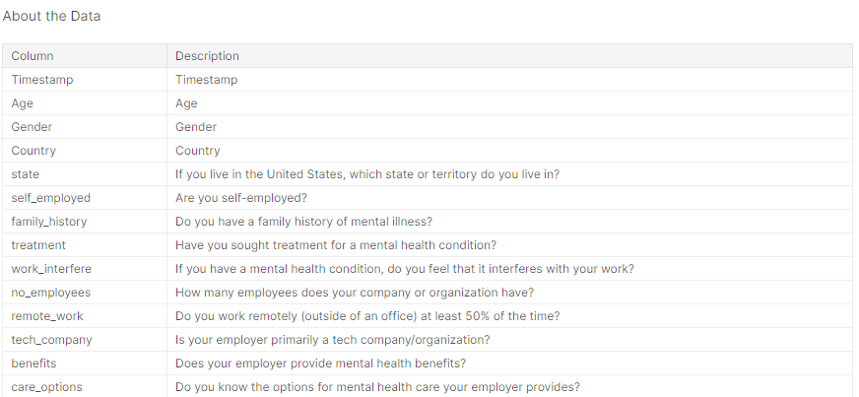
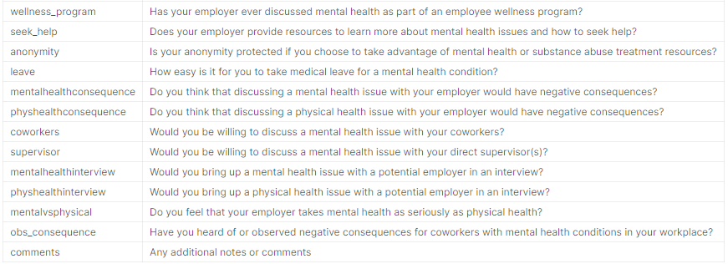

Slide 7

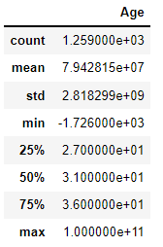
Understanding the Dataset
The Dataset contains 1259 Records and 27 Columns
We can see that all the features are of object data type, except serial number and age.
But timestamp is wrongly attributed as object which should be datetime datatype .
We will convert the datatype of timestamp.
But in age we see some discrepancy . The maximum age is 99999999999
and the minimum is -1726.We need to handle these data.

Slide 8
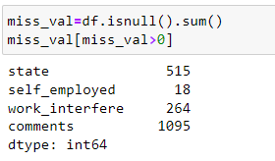
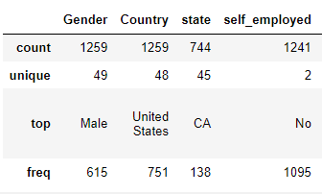
From the below output we can see that the state , self-employed , work interfere and
the comments columns have missing data . We will handle these columns.
We see that in gender column there are 49 unique values .
We need to see this column for any redundancy or error. The country column has 48 unique
values and the data has been maximum taken from United States and
the frequency is 751 out of 1259.

Slide 9
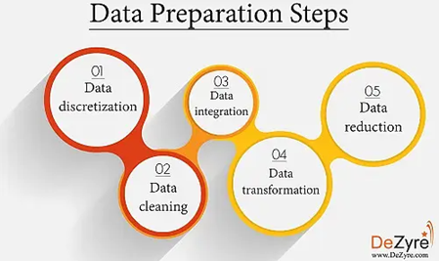
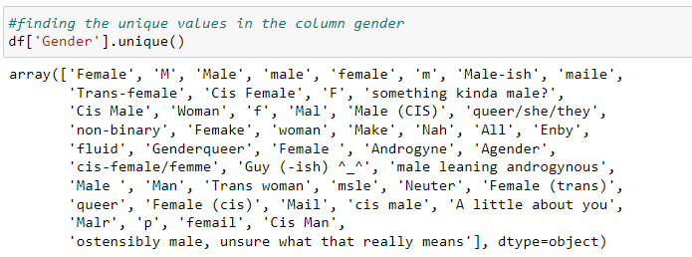

Data Preparation
We see that there are lots of misspelled words and synonym’s have been used.
This is the reason there are 49 unique values. We will convert them into 3 parts male(M),
female(F) and transgender(T).

Slide 10
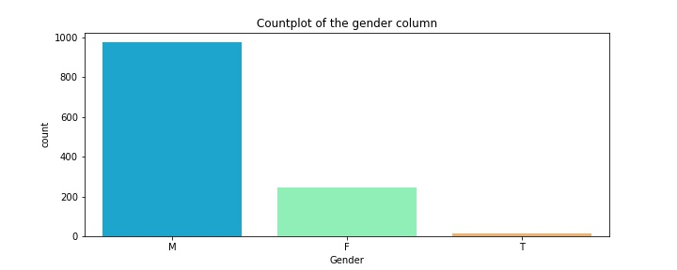
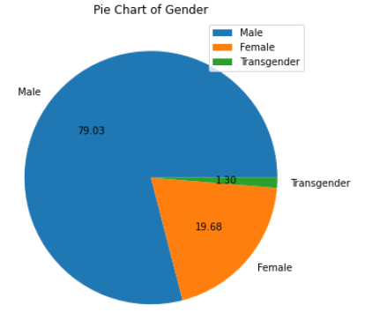
After Replacing the value counts of the Gender column
From the plot and the function .value counts() it can be clearly seen
that the number of males in the data set are 993,females are 248 and transgender are 18.

Slide 11
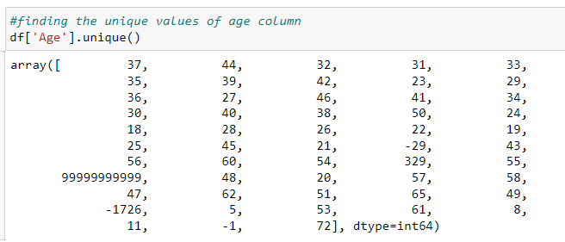
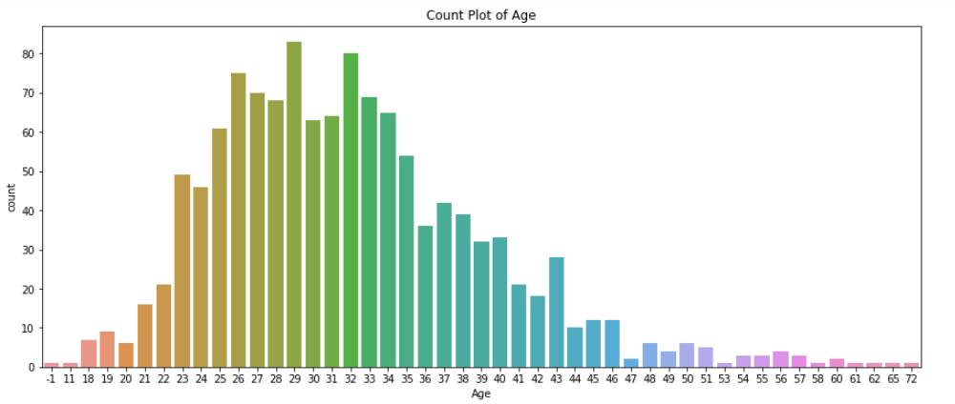
Finding the Unique value of Age
There are lot of typo error in the Age columns where the age cannot be 99999999999, -1726,
5, -1, 8, -29, 329. So we removed those records

Slide 12
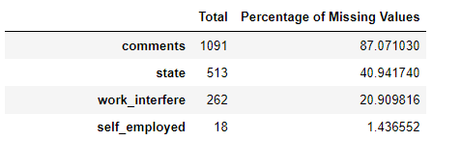
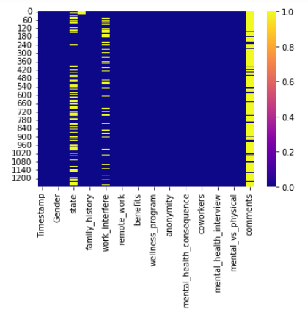
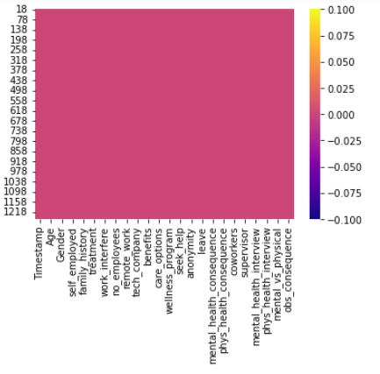
Treating Null Values
Before Treating
After Treating

Slide 13
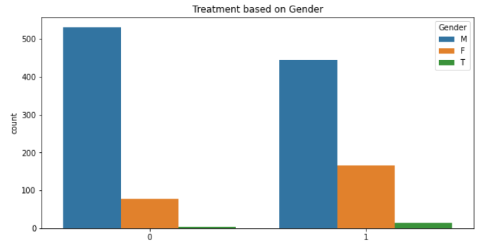
It can be clearly seen that Male requires highest treatment when
compared to Female and Transgender

Slide 14
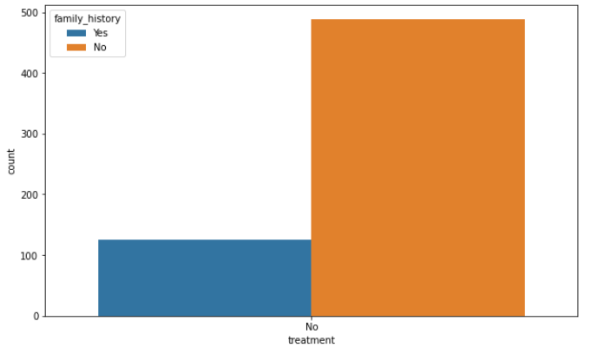
Employees With Family History Of Mental Illness Needs Treatment More Than Those Who Doesn't Have Any Family History Of Mental Illness.

Slide 15
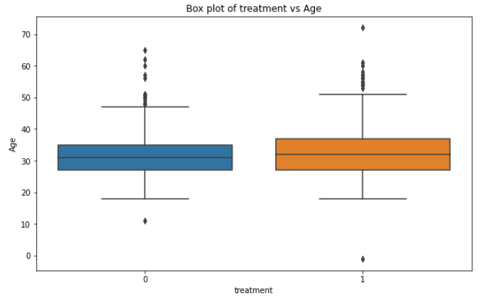
We see that age of people who requires treatment are in the range
of 20-50years approximately.

Slide 16
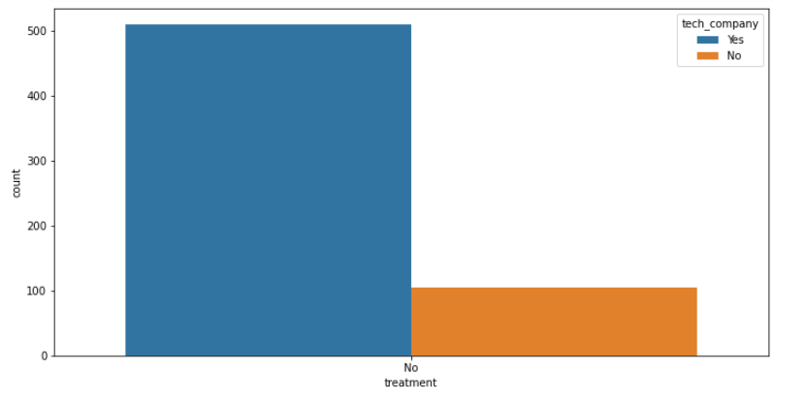
From the plot we can see that the tech company employees need more treatment than organization employees.

Slide 17
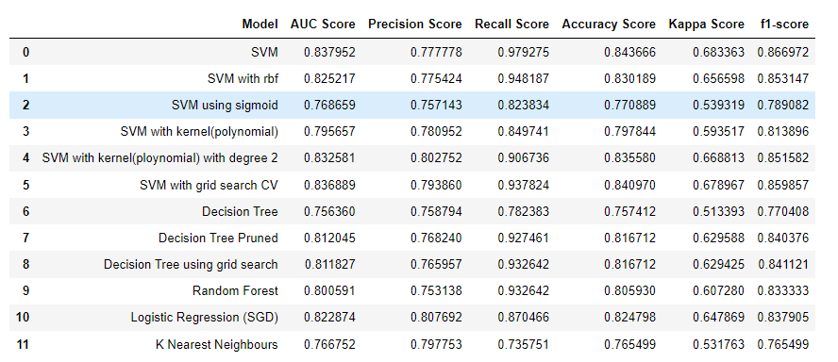
Building the Model Based on all the algorithm

Slide 18
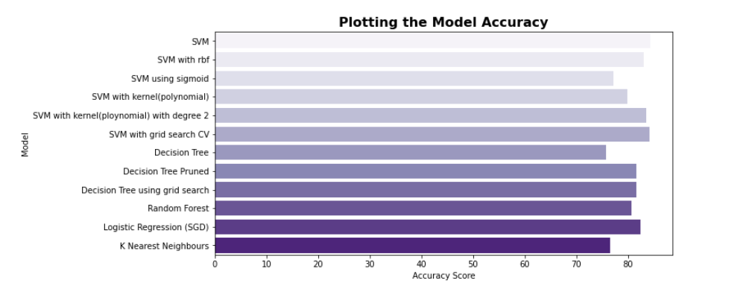
Will Visualize which model is giving the Highest Accuracy

Slide 19
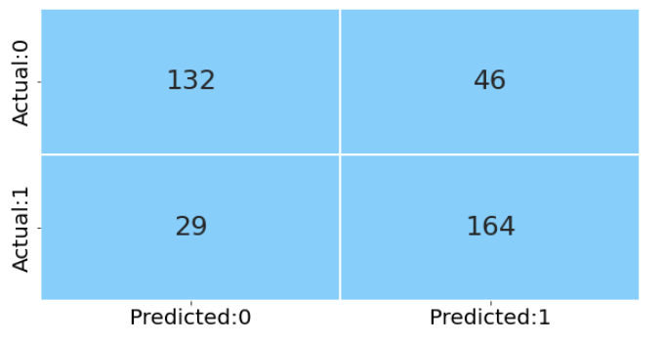
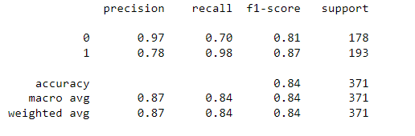
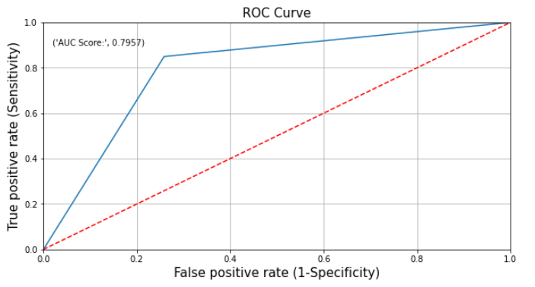
We got Highest Accuracy Score By using SVM [Support Vector Machine] by using Kernel =Linear

Slide 20

Challenges in the Project/Data
Some of the features were having missing values [Handling the missing values]
Most of the features were not having numeric type So we learnt how to convert the object datatype in to numeric using OHE[One Hot Encoding of get_dummies] [converting the object Dtypes to numeric where machine learning can understand]

Slide 21
In Timestamp both data and time where included so we split the data in to Date
and Time as an separate variable and we converted object datatype into date timestamp
There were lot of Typo error in the Age column where column so we figured out and we fixed it
We saw that there are lots of misspelled words and synonym's have been used in Gender Column So we figured out and We converted 49 Unique values to 3 levels. The Three levels of Gender columns has male(M),female(F) and transgender(T).
The Data was not in the same Scale so we need to scale down the data
There were 26 Feature to predict the whether the person seeks the treatment or not where not all 26 Features are important to predict the target variable so we reduced some of the features

Slide 22

Major Findings through EDA
By doing some analysis it can be clearly seen that male requires more treatment
when compared to female and transgender
We can see that the employees who don't know whether they will get leave for
medical health condition requires treatment
Who Employees with family history of mental illness needs treatment more than those
doesn't have any family history of mental illness

Slide 23
The employer who never discussed mental health as part of an employee wellness program
are more prone to treatment requirement.
From the plot we can see that the tech company employees need more treatment than
organization employees.
We see that age of people who requires treatment are in the range of 20-50years
approximately.
We can see from the plot that organization have 26-100 employees and
those having more than 1000 employees requires more treatment.
So we can not conclude much from the organizational strength of employees.

Slide 24

My Learning in the Project
Learnt how to find the insights from the data by visualizing the plots
We learnt how to Extract the Feature from one Feature
Learnt how to Perform Feature Extraction

Slide 25
We learnt how to use RFE [Recursive Feature Elimination] method to select the variable
We learnt how to scale down the data and bring the data into Same scale
We learnt how to perform PCA [Principle Component Analysis]
Learnt how to Build Model by using different Classification Algorithms
Learnt how to use Grid Search and Randomized Search CV
Learnt how to perform Hyperparameter Tuning

Slide 26
Algorithm used to Build the Model
SVM [Support Vector Machine]
SVM with RBF [Radial Basis Function]
SVM using Sigmoid
SVM with Kernel Polynomial
SVM with Grid Search
Decision Tree
Decision Tree Pruned
Decision Tree using Grid Search
Random Forest
Logistic Regression
K Nearest Neighbour

